Slide 1
(Not so?) FUN3D
Status updates

Slide 2
Status
Flux jacobian kernel team:
Abandoned porting manually unrolled, heavily CPU optimized, tet. specific version in favor of more general (tet, prism, etc.) version without unrolled loops
First hack at kernel had/has insidious correctness problems
15.1093… 15.10 that is… compiler bugs causing errors in Fortran IO made debugging hard (late night award?)
Updated compiler on Pleiades to 16.4
But needed workaround to allow cpu and gpu code to run with 16.4
Fingers crossed we can trust our print statements issued on the host
Enable RDMA on SGI MPT… ongoing (multi-month)

Slide 3
Status
MIT 1-D solver team (Piotr)
We have split out to address other issues while the viscous jacobian issues are blocking
Currently has old CUDA 6 reductions, thinking of switching to warp shuffles

Slide 4
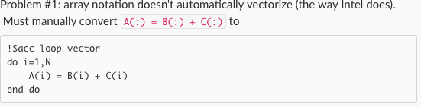
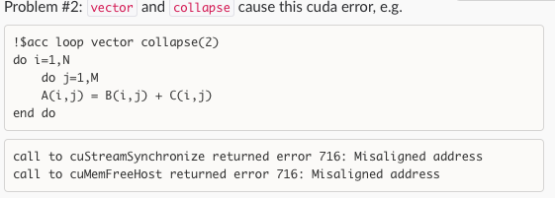
Status
SFE team (Kyle & John)
Great payoff for loop vector collapse(2) if able to resolve compiler issues

Slide 5
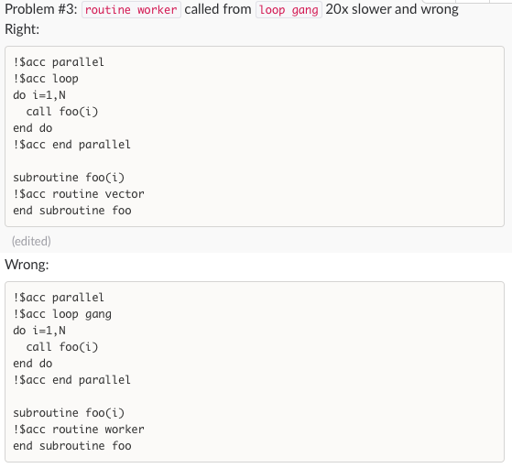
Status
SFE team (Kyle & John)

Slide 6
Status
Point solver
Sparse block kernel
Yesterdays results not a fair comparison
Have a version with fair comparison, looks promising, validate and present tomorrow

